Slide 1
Capacity Planning & Cloud Brokers
Resource Allocation, Cost Optimization, and the Cloud Broker Role

Slide 2
Overview
Key Sections:
What is Capacity Planning?
Resource Allocation in Cloud Environments
Role of Cloud Brokers
Cost Optimization Strategies
Integration of Capacity Planning & Cloud Brokers
Case Study/Examples
Challenges & Best Practices

Slide 3

Capacity Planning
Capacity planning is a strategic process that helps businesses ensure they have the IT resources to meet customer demand
Objectives:
Avoid over/under-provisioning.
Ensure scalability.
Minimize costs.

Slide 4
Key Components:
Demand forecasting.
Resource scalability planning.
Performance monitoring.

Slide 5
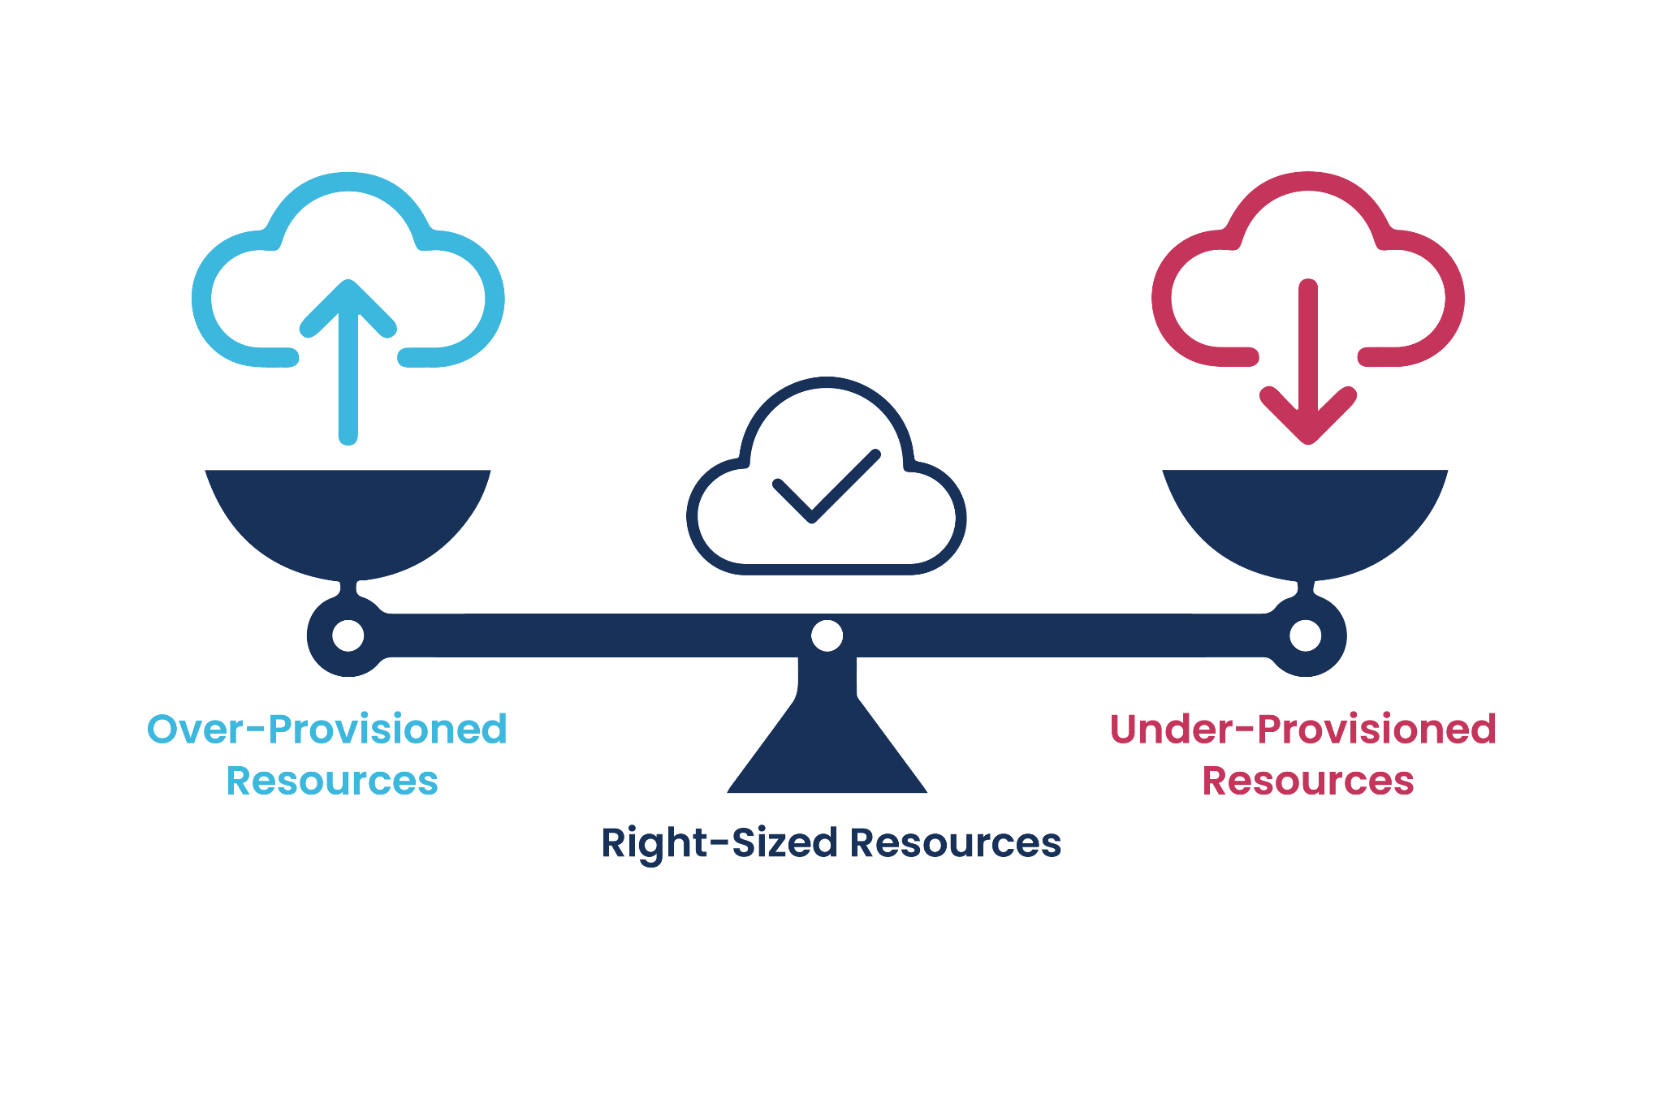
Resource Allocation in Cloud Environments
Definition: Assigning cloud resources to workloads efficiently.
Static vs. Dynamic allocation:
Static: Predefined resource allocation.
Dynamic: Adjusts based on real-time needs.
Autoscaling: AWS Auto Scaling, Kubernetes Horizontal Pod Autoscaler.

Slide 6
Challenges:
Over-provisioning (wasted costs).
Under-provisioning (performance issues).

Slide 7
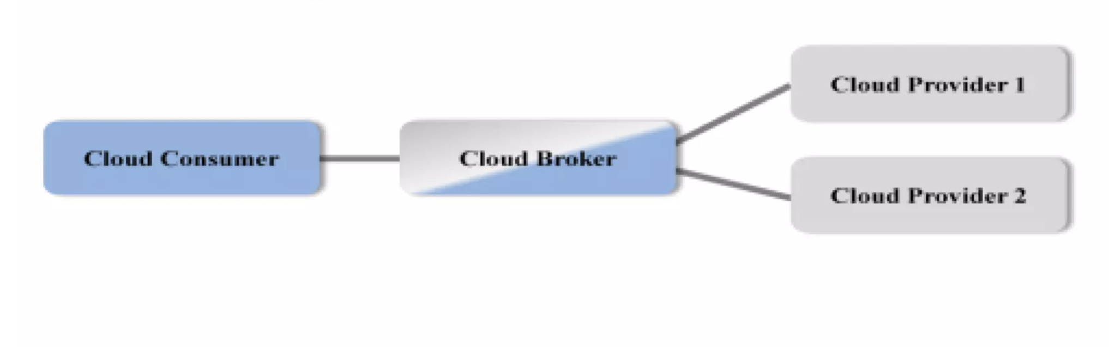
Role of Cloud Brokers
Cloud Brokers: A third-party intermediary that manages cloud services across multiple providers.
Responsibilities:
Vendor selection and negotiation.
Cost optimization through pricing analysis.
Centralized monitoring and governance.

Slide 8
Benefits:
Simplified multi-cloud management.
Reduced administrative overhead.

Slide 9
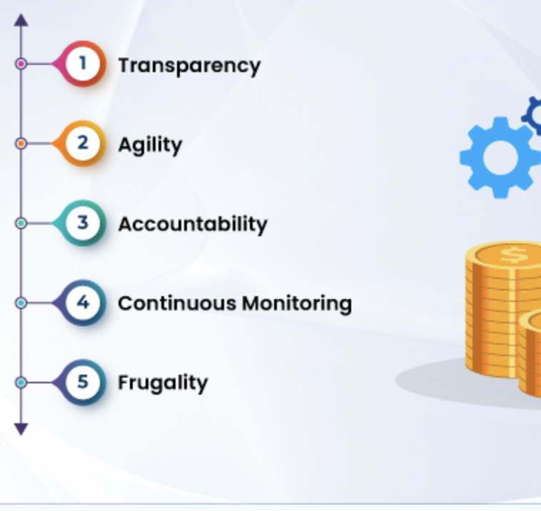
Cost Optimization Strategies
Reserved Instances: Pre-purchase discounted capacity.
Spot Instances: Use unused cloud capacity at lower rates.
Right-Sizing: Match resources to actual workload needs.
Automated Tools: Leverage AI/ML for cost analytics.

Slide 10
Challenges:
Hidden costs (e.g., data transfer fees).
Complex pricing models.

Slide 11
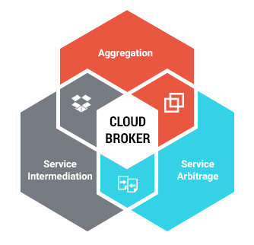
Integrating Capacity Planning & Cloud Brokers
How Brokers Assist:
Analyze historical data for accurate forecasting.
Automate resource scaling based on policies.
Negotiate better pricing with providers.
Benefits:
Reduced manual intervention.
Improved cost-performance balance.

Slide 12
Case Study/Examples
A company uses AWS EC2 with a cloud broker tool to:
Forecast peak holiday traffic.
Automatically scale resources.
Reduce costs by 30% using reserved instances.

Slide 13
Outcome:
Zero downtime during traffic spikes.
25% lower annual cloud spend.

Slide 14
Challenges & Best Practices
Challenges:
Unpredictable demand spikes.
Vendor lock-in risks.
Best Practices:
Regularly review capacity plans.
Use multi-cloud strategies to avoid lock-in.
Monitor costs with dashboards.

Slide 15
Conclusion
Capacity planning ensures efficient resource use.
Cloud brokers simplify multi-cloud management.
Cost optimization requires strategic tools and planning.

